Slide 1

Software Engineering Principles
PUBLIC - Software engineers shall act consistently with the public interest.
CLIENT AND EMPLOYER - Software engineers shall act in a manner that is in the best interests of their client and employer consistent with the public interest.
PRODUCT - Software engineers shall ensure that their products and related modifications meet the highest professional standards possible.
JUDGMENT - Software engineers shall maintain integrity and independence in their professional judgment.
MANAGEMENT - Software engineering managers and leaders shall subscribe to and promote an ethical approach to the management of software development and maintenance.
PROFESSION - Software engineers shall advance the integrity and reputation of the profession consistent with the public interest.
COLLEAGUES - Software engineers shall be fair to and supportive of their colleagues.
SELF - Software engineers shall participate in lifelong learning regarding the practice of their profession and shall promote an ethical approach to the practice of the profession.

Slide 2
Copyright
Utilized asset: Created illustrations by other artists of different weapons,
powerups, health items, and coins. The illustrations are a creative work from
different artists, which is protected under Copyright law.
The four factors judges consider in fair use are:
Purpose and character of your use (nonprofit/educational vs. commercial) (transformative)
My use is transformative: I’ve added a new context to the images rather than substituting the original. I turned non-related images that were created into a video game.
Nature of the copyrighted work (factual vs. creative)
These images have been published and licensed by the illustrator.
These are illustrations of actual legitimate items. (Sword, AK-47, Baseball Bat, Bitcoin, etc.)
Amount and substantiality of the portion taken.
These images are not the main component of the game.
Each image used was from a separate illustrator. (Only 1 image stolen from any one person).
Effect of the use upon the potential market.
This use does not compromise the market of illustrating images and pixelart.
Video games and pixel art and image creation are all separate markets.

Slide 3
Prefabs
Weapon Items:
MeleeWeapons:
Sword, Baseball Bat, Battle Axe, Broom, Clubber, Hammer, Machete, Pipe Wrench, Shovel, Umbrella
Powerup Items:
Attack Rate Increase, Damage Increase, Jumping Increase, Speed Increase
Health Items:
Health Increase
Coins
Coins

Slide 4
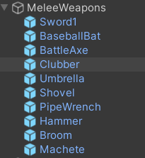
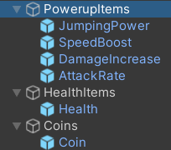
Prefabs
MeleeWeapons Include:
Sprite images
Attack animations(swinging weapon)
BoxCollider2D for collision detection
Powerup Items Include:
Sprite images
BoxCollider2D for collision detection
References to other scripts to alter players/weapon
attributes
Health Item Includes:
Sprite image
BoxCollider2D for collision detection
References to player script to alter player health
Coin Item Includes:
Sprite image
BoxCollider2D for collision detection
References to player script to alter player coin numbers

Slide 5
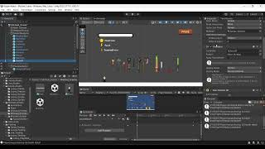
Prefabs
Show video:

Slide 6
Factory Method Pattern
Pros:
Encapsulation: It encapsulates the object creation logic within the factory class. This promotes loose coupling between the client code and the concrete classes being created.
Flexibility: It allows subclasses to alter the type of objects that will be created, providing flexibility in object instantiation. This makes it easy to add new products or variations without modifying existing code.
Abstraction: The pattern promotes the use of interfaces or abstract classes for the products, allowing the client code to work with abstractions rather than concrete implementations. This enhances code maintainability and extensibility.
Testability: By coding against interfaces or abstract classes, unit testing becomes easier as mock objects can be substituted for real objects during testing.
Decoupling: It decouples the client code from the concrete classes, reducing dependencies and making the system easier to maintain and scale.

Slide 7
Factory Method Pattern
Cons:
Complexity: Introducing multiple factory classes can increase the complexity of the codebase, especially if there are many product types or variations. Took me some time to figure out.
Overhead: May introduce additional overhead in terms of code size and runtime performance due to the creation of factory classes and the additional abstraction layer.
Inflexibility: Adding new product types may require creating new subclasses of the factory class, which can lead to a proliferation of classes and increased complexity.
Tight Coupling with Concrete Factories: If the client code directly references concrete factory classes instead of using abstractions, it can lead to tight coupling and reduced flexibility.

Slide 8
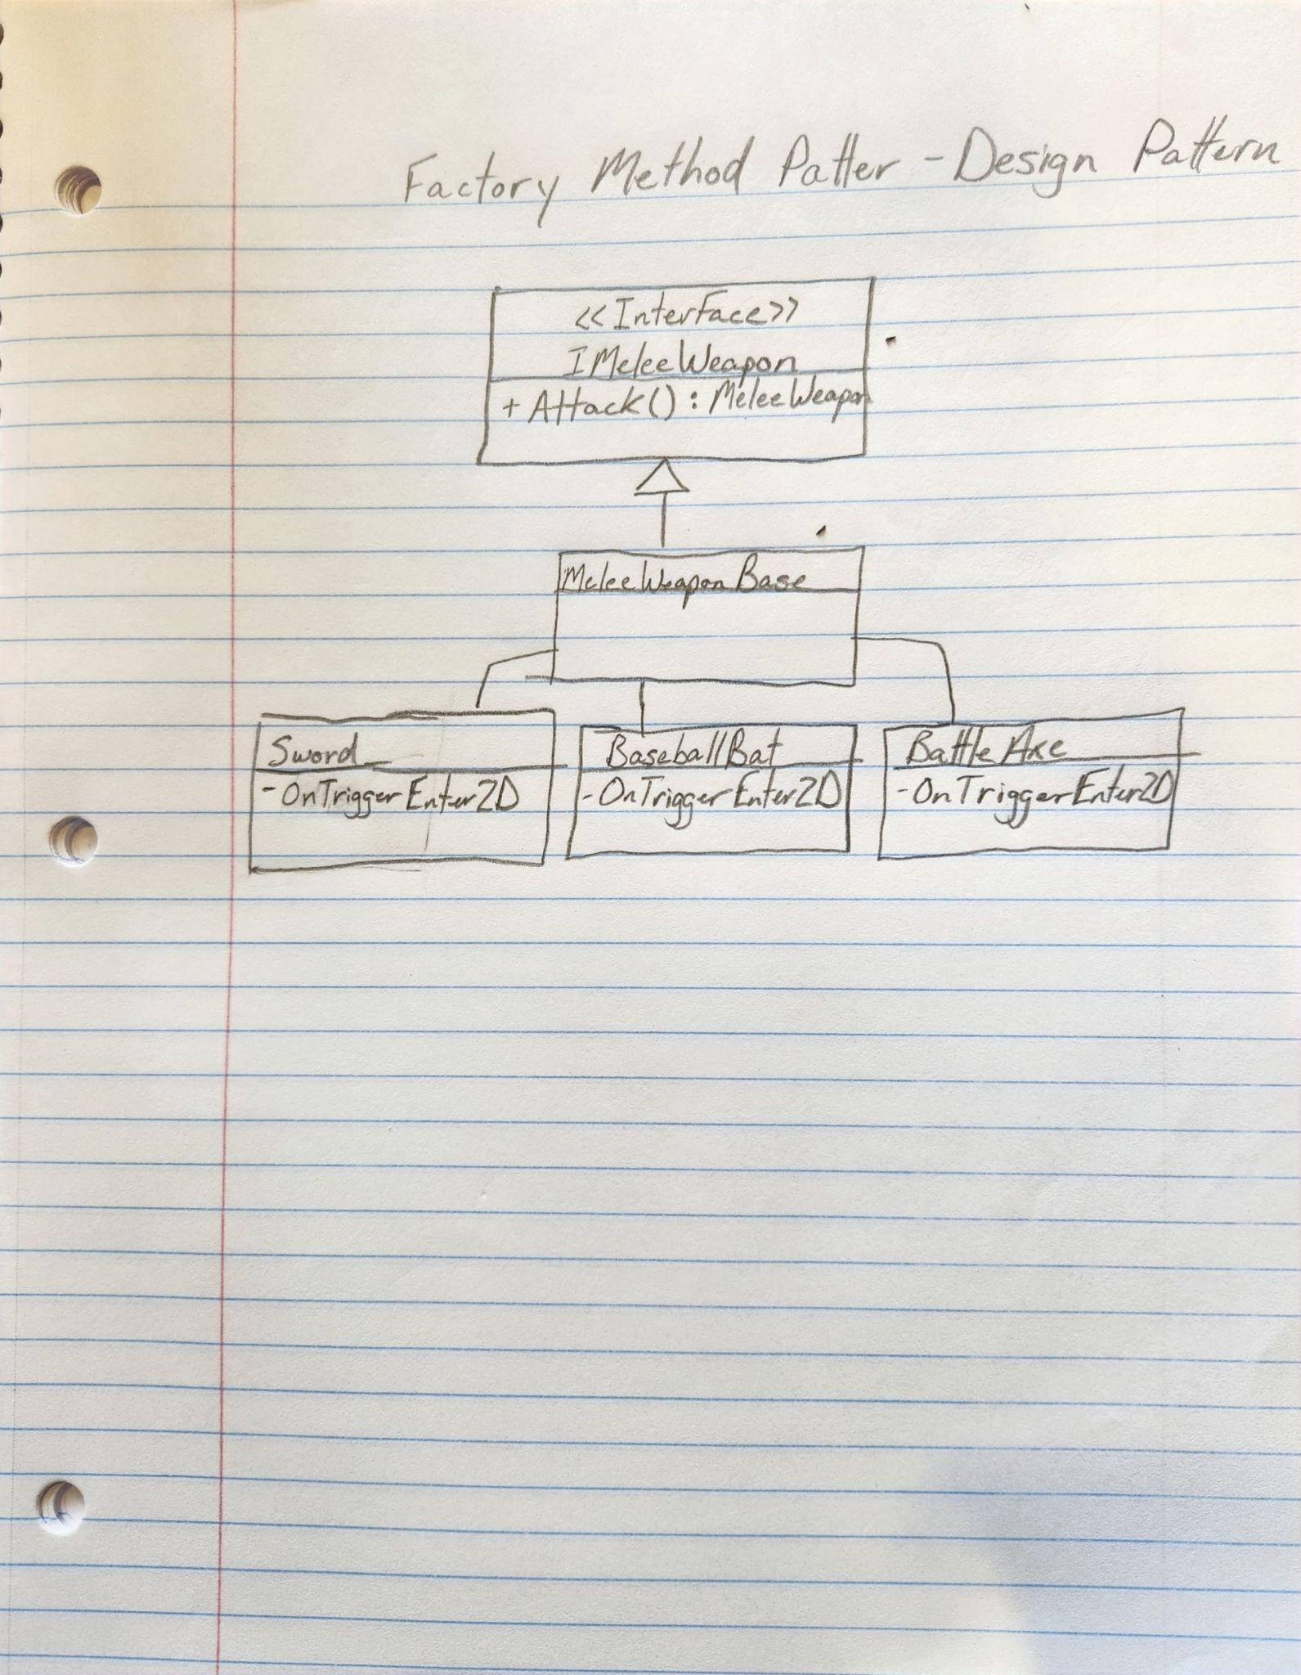
Factory Method Pattern

